Slide 1
Anh Tran (SNL); Julien Tranchida (CEA Cadarache)
Multi-fidelity Gaussian process and Bayesian optimization for materials design: Application to ternary random alloys
Tran, A., Tranchida, J., Wildey, T., & Thompson, A. P. (2020). Multi-fidelity machine-learning with uncertainty quantification and Bayesian optimization for materials design: Application to ternary random alloys. The Journal of Chemical Physics, 153(7), 074705.
Sandia National Laboratories is a multimission laboratory managed and operated by National Technology and Engineering Solutions of Sandia, LLC., a wholly owned subsidiary of Honeywell International, Inc., for the U.S. Department of Energy’s National Nuclear Security Administration under contract DE-NA-0003525. The views expressed in the article do not necessarily represent the views of the U.S. Department of Energy or the United States Government.
Notes:
1

Slide 2
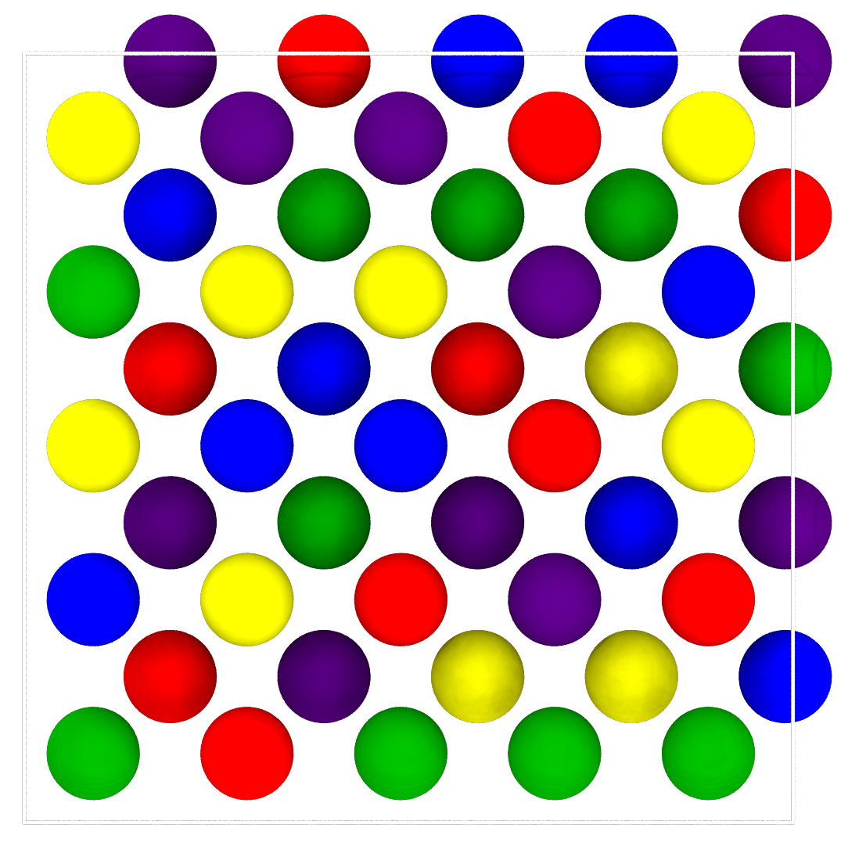
The problem we are trying to solve
High entropy alloys
Materials design problem
Random alloys with four or more principal components.
Materials design can be seen as an inverse problem in the structure-property relationship.
HEAs are promising materials (refractory and aerospace applications, nuclear degradation-resistant materials, …).
In the context of modern random alloys, optimizing functional performances requires the exploration of vast composition spaces.
At Sandia, HEAs are manufactured by additive manufacturing techniques.
The developed ML approaches will be applied to exploring functional properties of different alloy compositions: AlNbTi, MoNbTaW, ...
Prototypical compositions: FeCoCrMnNi, MoNbTaW.
Comparisons to experimental measurements of additive manufacturing based HEAs performed at Sandia will allow to probe our methods.

Slide 3
The problem we are trying to solve
High entropy alloys
Machine-learning problem
Random alloys with four or more principal components.
The predicting capabilities of high-accuracy first-principles methods, such as Density Functional Theory (DFT) is limited by their computational cost.
HEAs are promising materials (refractory and aerospace applications, nuclear degradation-resistant materials, …).
Machine-Learning interatomic potentials (ML-IAP) are emerging as a promising solution to reduce this cost while preserving accuracy.
At Sandia, HEAs are manufactured by additive manufacturing techniques.
Prototypical compositions: FeCoCrMnNi, MoNbTaW.
However, the use of DFT and ML-IAP remains mostly segregated.
We leverage Gaussian process and Bayesian optimization to fuse the predictions of DFT and ML-IAP, and develop a multi-fidelity framework for random alloys. We use it to accurately and efficiently predict materials properties.

Slide 4
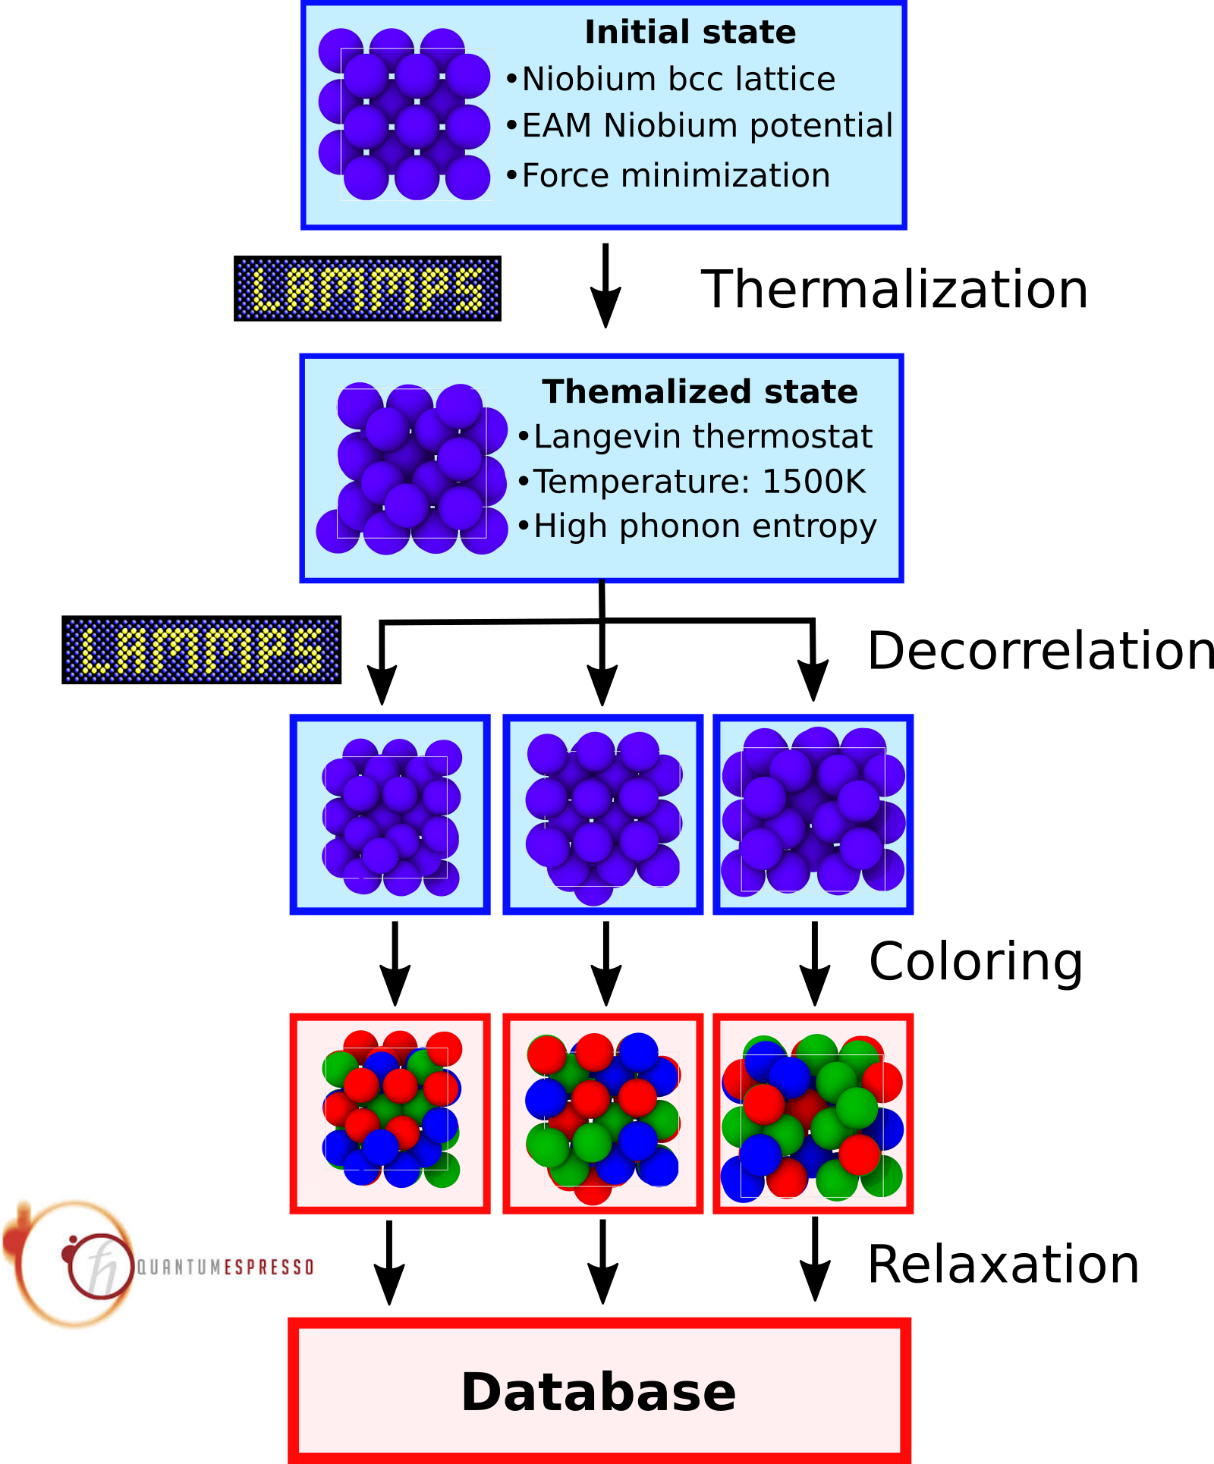
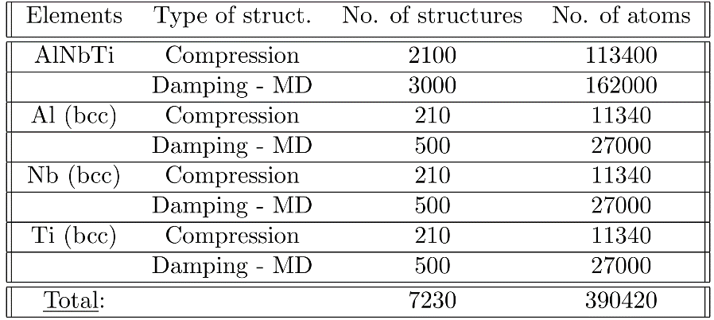
SNAP potential for ternary random alloy
A framework was developed to generate a DB for ternary composition.
Generated SNAP training set:
“Large” but unbalanced dataset: a lot of atomic configurations, but mainly at equicomposition.
We only work on bcc structures.

Slide 5
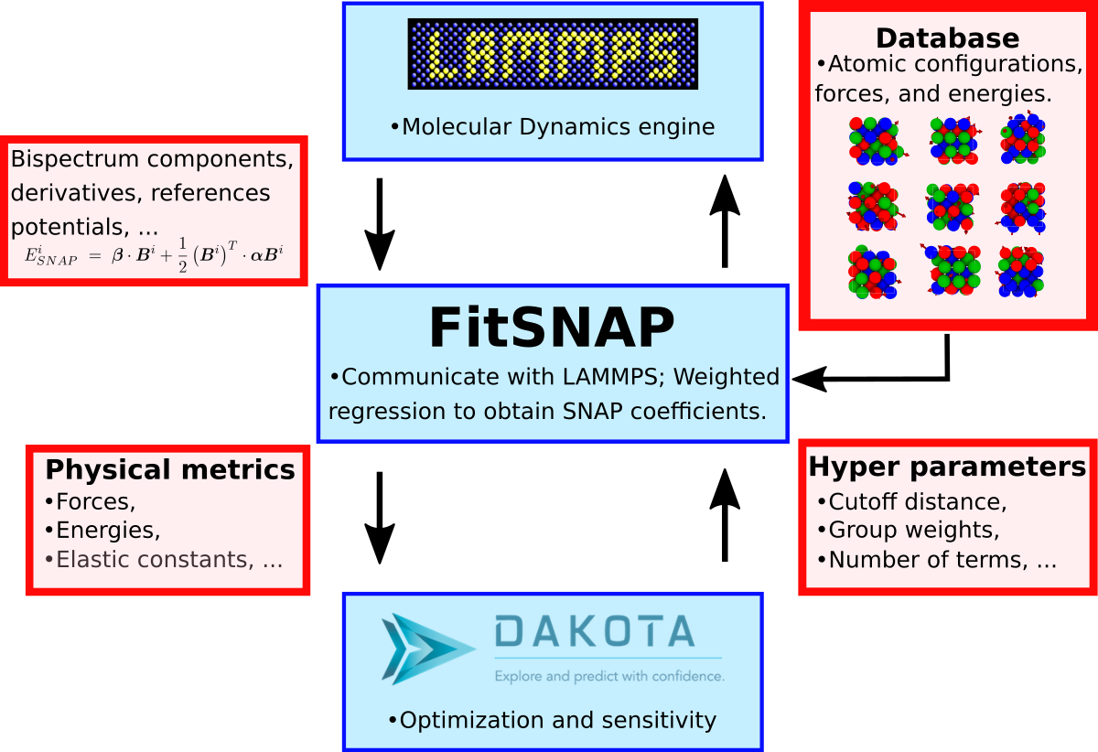
SNAP potential for ternary random alloy
A framework was developed to generate a DB for ternary composition.
SNAP - Dakota machinery:
A SNAP IAP for AlNbTi was trained on the generated training set.
Thompson, A. P., et al.. (2015). J. Comp. Phys., 285, 316-330.

Slide 6
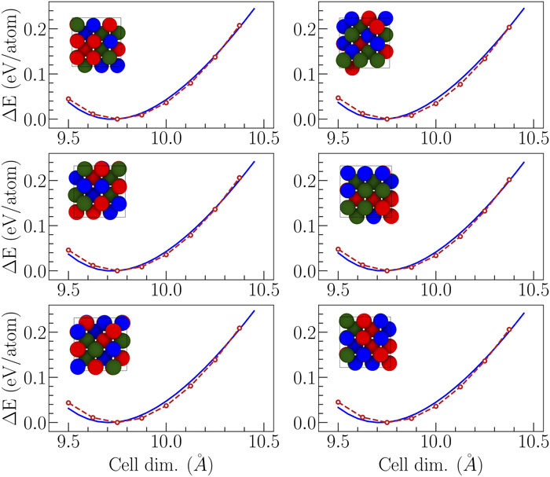
Focus on one property: the bulk modulus
The data consists of High- and Low-fidelity bulk modulus calculations accros the AlNbTi composition space.
We leveraged two atomistic approaches:
Ab initio calculations
We used density-functional theory as implemented in Quantum Espresso.
Slow calculations, but accurate for materials design.
High-Fidelity (HF) Data
Classical potential calculations
We used LAMMPS and a Machine Learning SNAP interatomic potential.
Orders of magnitude faster than HF, but less accurate for materials design.
Low-Fidelity (LF) Data

Slide 7
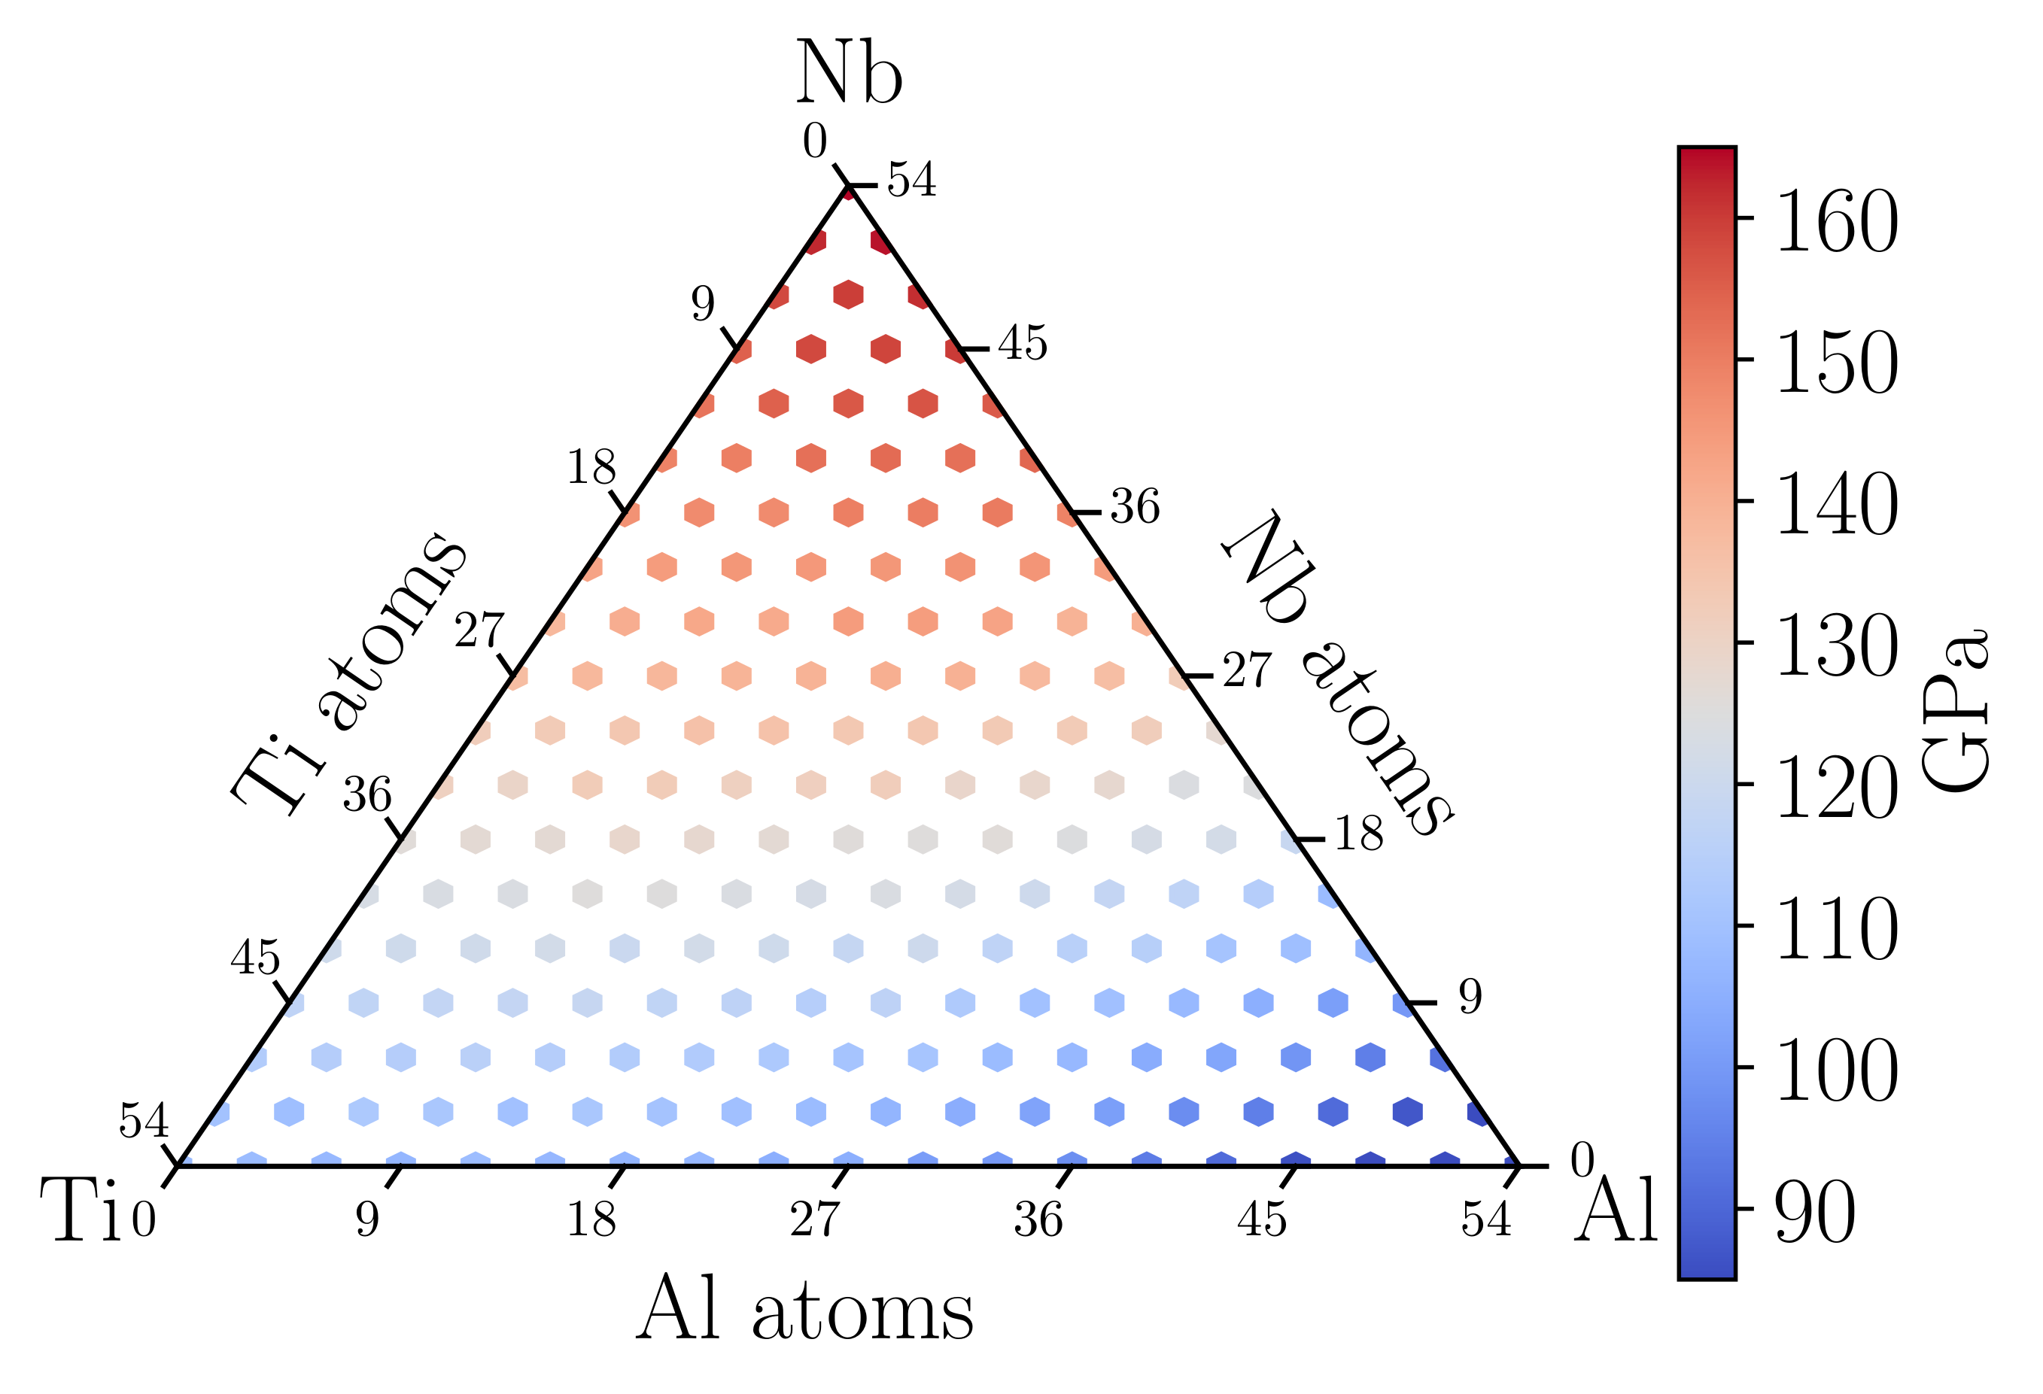
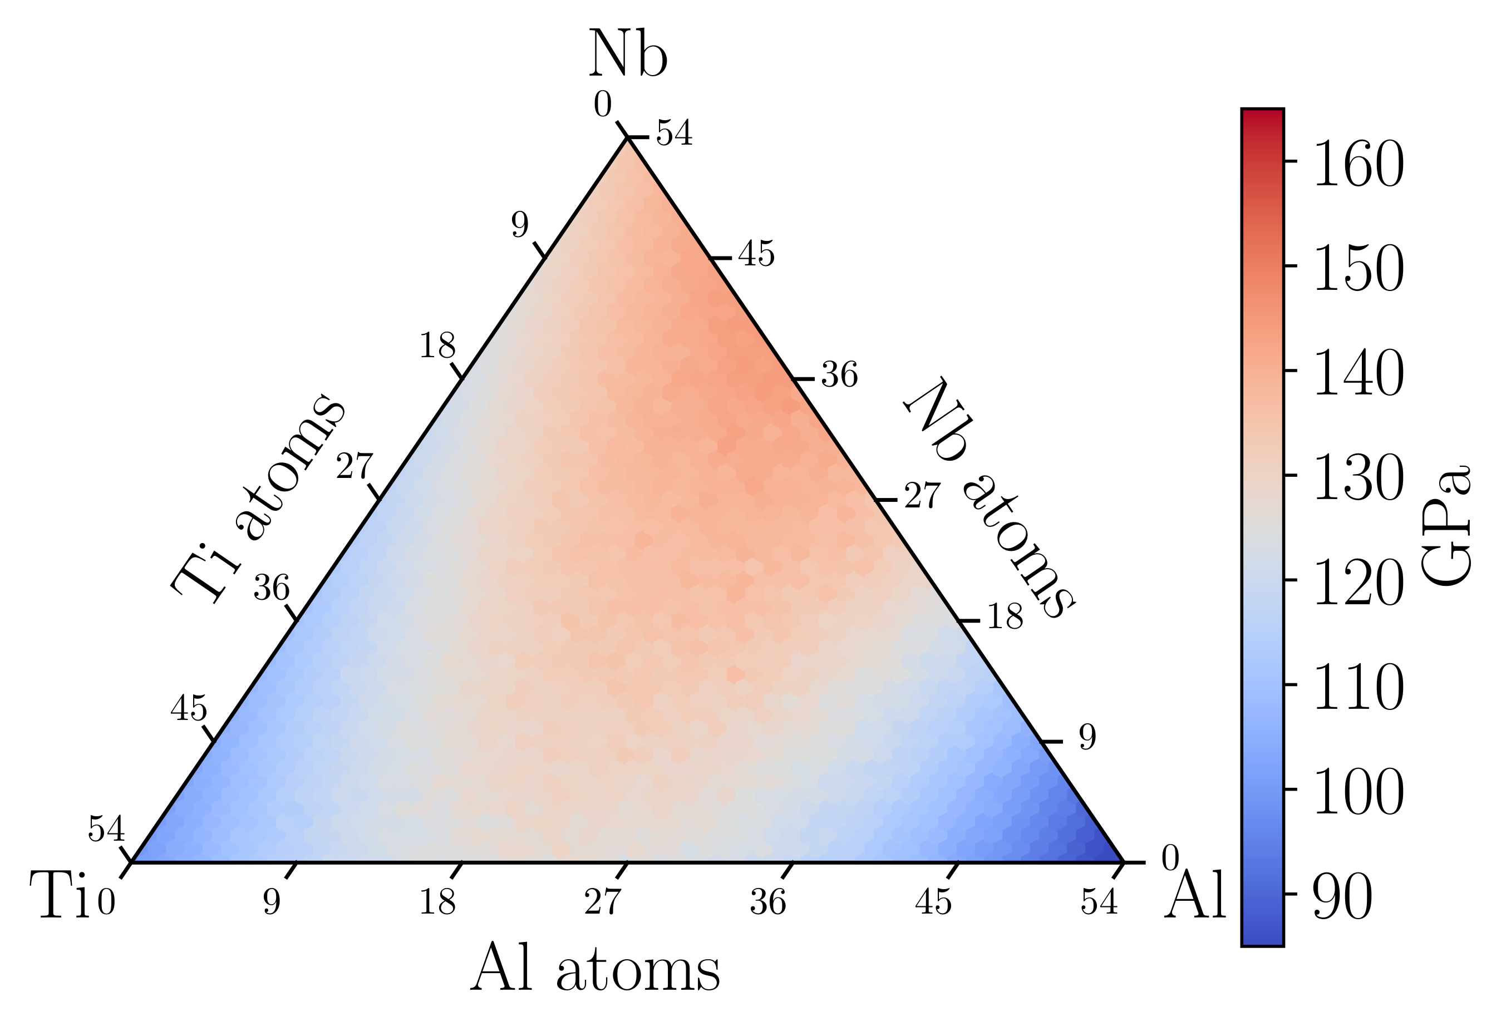
Focus on one property: the bulk modulus
For each composition across the AlNbTi diagram, Equation of State (EOS) calculations are performed. Their fitting (Birch-Murnaghan polynomials) allows to extract the bulk modulus:
HF bulk modulus predictions
LF bulk modulus predictions
This HF and LF data is used as a training and testing set for the Gaussian process model.

Slide 8
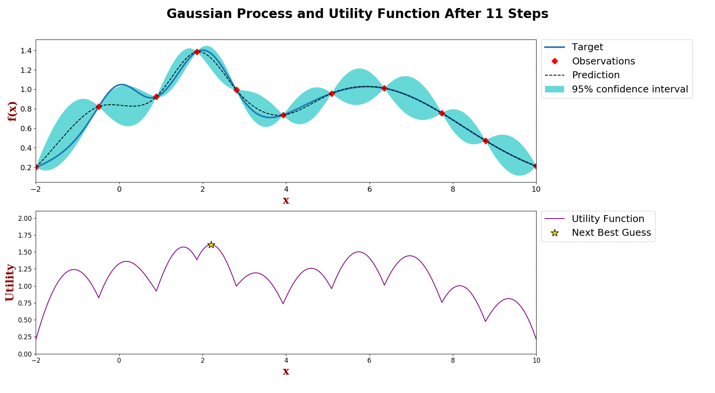
Gaussian process - Introduction
A powerful and flexible framework
And versatile, but in what sense?
Multi-objective
Multi-task
Multi-fidelity
Mixed-integer
Scalable for Big Data
High-dimensional
Asynchronous parallel
And more
An animation of Bayesian optimization
Notes:
8

Slide 9
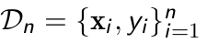
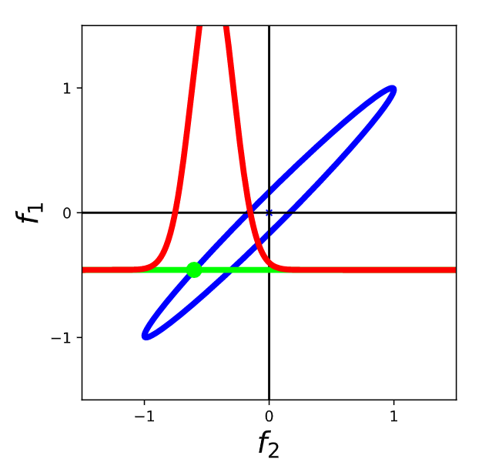
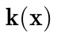
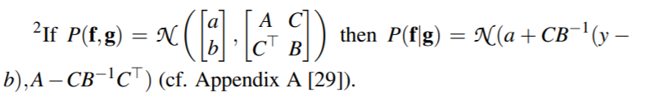
Gaussian process - Introduction
Let denote the set of observations
denote an arbitrary test points
Prediction is a Gaussian distribution
is a vector of covariance terms.
A conditional of a Gaussian is Gaussian.
Photo courtesy of Neil Lawrence. http://inverseprobability.com/talks/notes/gaussian-processes.html
Notes:
9

Slide 10
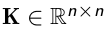
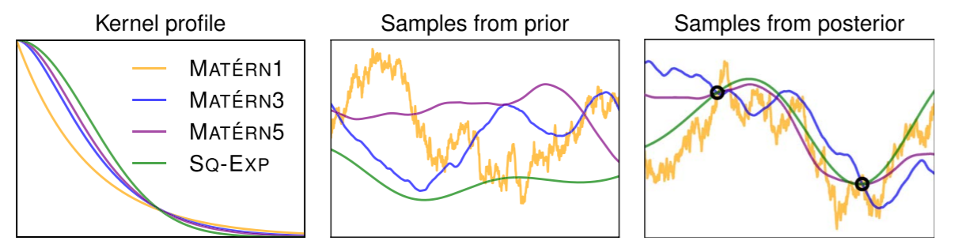
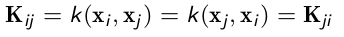
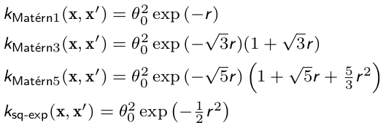
Gaussian process - Introduction
B. Shahriari, K. Swersky, Z. Wang, R. P. Adams, and N. de Freitas, Proc. IEEE 104, 148 (2016).
Kernels:
Stationary (default)
Anisotropic vs. isotropic
Symmetric positive semi-definite matrix
Many good choices
Affect smoothness of GP
(hint: first derivative at origin)
Notes:
10

Slide 11
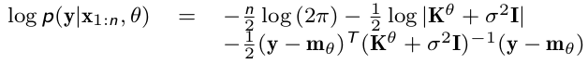
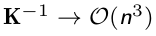
Gaussian process - Introduction
How to train a GP
Maximizing the log marginal likelihood function
Alternatively, can treat hyper-parameters as stochastic parameters and marginalize out using MC
Complexity
More computationally expensive with more data
Approximations are available to reduce complexity at the cost of accuracy, e.g. low-rank approx.
Snoek, J., Larochelle, H., & Adams, R. P. (2012). Practical bayesian optimization of machine learning algorithms. Advances in neural information processing systems, 25.
Notes:
11

Slide 12
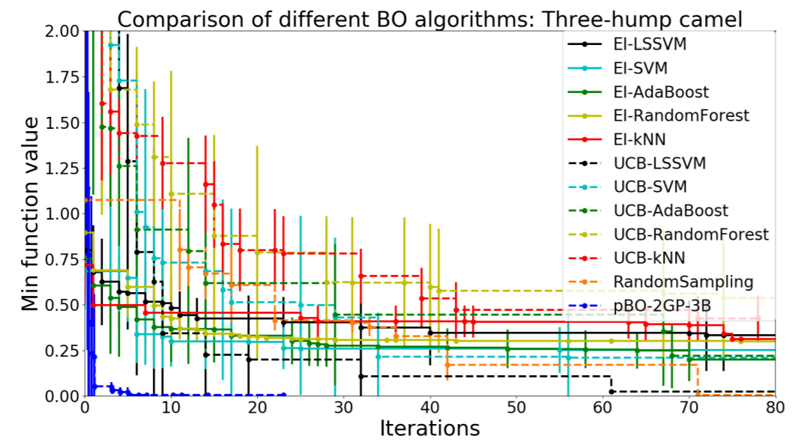
Gaussian process - Introduction
What is the point of optimization?
Everything is about efficiency
Crux: how to select the next input parameters
Debate of optimization policies
Bayesian optimization is a gradient-free approach
Next input parameters are found by maximizing acquisition function
Active learning: balancing exploration vs. exploitation
Minimal dataset
Notes:
12

Slide 13
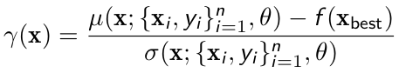
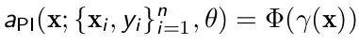
Gaussian process - Introduction
Mockus, Jonas (1975). “On Bayesian methods for seeking the extremum”. In: Optimization Techniques IFIP Technical Conference. Springer, pp. 400–404.
Mockus, Jonas (1982). “The Bayesian approach to global optimization”. In: System Modeling and Optimization, pp. 473–481
Srinivas, Niranjan et al. (2009). “Gaussian process optimization in
the bandit setting: No regret and experimental design”. In: arXiv
preprint arXiv:0912.3995.
Srinivas, Niranjan et al. (2012). “Information-theoretic regret
bounds for Gaussian process optimization in the bandit setting”.
In: IEEE Transactions on Information Theory 58.5,
pp. 3250–3265.
Acquisition function
Probability of improvement (PI)
Expected improvement (EI)
Upper confidence bound (UCB)
Notes:
13

Slide 14
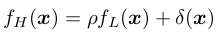
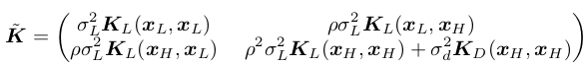
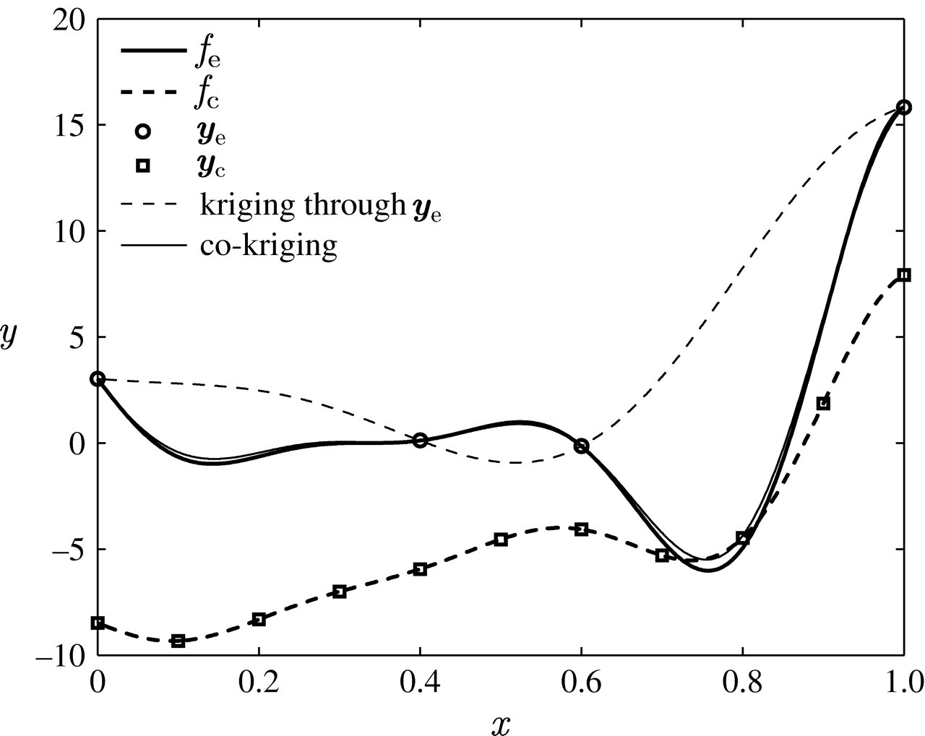
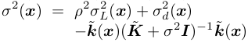
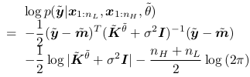
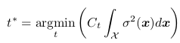
Gaussian process - Multi-fidelity
1. Kennedy, Marc C and Anthony O’Hagan (2000). “Predicting the output from a complex computer code when fast approximations are available”. In: Biometrika 87.1, pp. 1–13
2. Yang, X., Zhu, X., & Li, J. (2020). When bifidelity meets cokriging: An efficient physics-informed multifidelity method. SIAM Journal on Scientific Computing, 42(1), A220-A249.
3. Xiao, M., Zhang, G., Breitkopf, P., Villon, P., & Zhang, W. (2018). Extended Co-Kriging interpolation method based on multi-fidelity data. Applied Mathematics and Computation, 323, 120-131.
4. Tran, A., Wildey, T., & McCann, S. (2020). sMF-BO-2CoGP: A sequential multi-fidelity constrained Bayesian optimization framework for design applications. Journal of Computing and Information Science in Engineering, 20(3).
5. Forrester, A. I., Sóbester, A., & Keane, A. J. (2007). Multi-fidelity optimization via surrogate modelling. Proceedings of the royal society a: mathematical, physical and engineering sciences, 463(2088), 3251-3269.
Auto-regressive formulation
Covariance matrix
Posterior mean
Posterior variance
Log marginal likelihood
Fidelity level to query
Photo courtesy of Forrester (2007).
Notes:
14

Slide 15
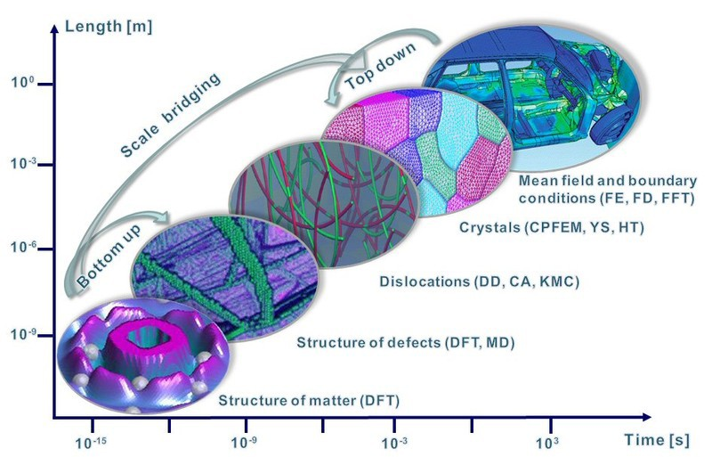
A multi-scale perspective
But try to look at this from a multi-fidelity perspective
Machine learning prediction is not very accurate, but computationally cheap
DFT is accurate, but expensive
Propose a multi-fidelity approach to support ML prediction with DFT when it’s necessary.
Photo courtesy of Dierk Raabe. http://www.dierk-raabe.com/multiscale-modeling/
Notes:
15

Slide 16
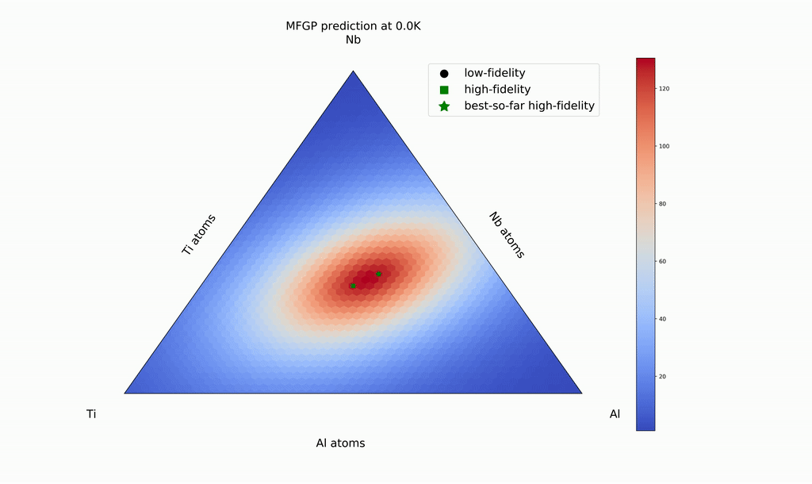
Multi-fidelity for multi-scale
Materials design: inverse problem
From chemical composition to materials properties
Notes:
16

Slide 17
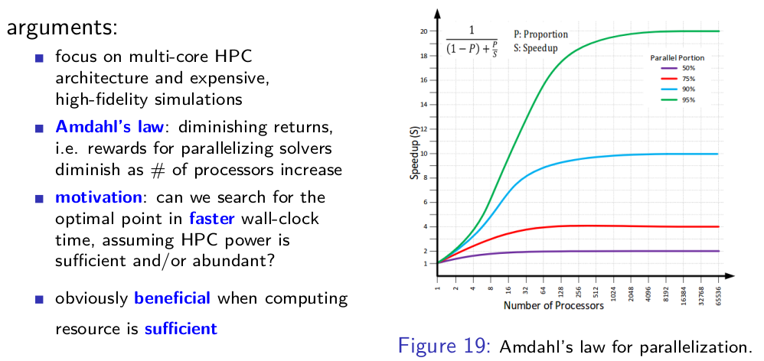
Bayesian Optimization Parallelism
A MPI perspective: Why parallelize optimization?
Notes:
17

Slide 18
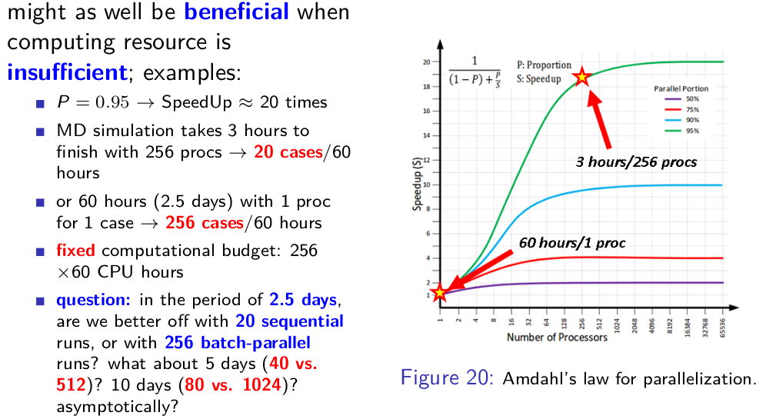
Bayesian Optimization Parallelism
A MPI perspective: Why parallelize optimization?
Notes:
18

Slide 19
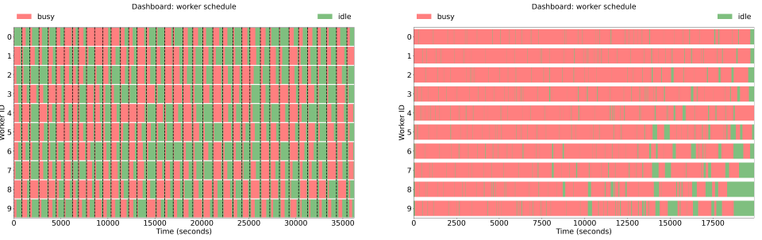
Bayesian Optimization Parallelism
A MPI perspective
Why asynchronous parallel?
Notes:
19

Slide 20

The code, the data, and the tutorials
https://dakota.sandia.gov/
Source code available: https://dakota.sandia.gov/download.html
A Sandia National Laboratories’s flagship software in uncertainty quantification and optimization
How to compile Dakota on Ubuntu 20.04 LTS: https://dakota.sandia.gov/content/linux-ubuntu-2004
apt-get install gcc g++ gfortran cmake libboost-all-dev libblas-dev liblapack-dev libopenmpi-dev openmpi-bin gsl-bin libgsl-dev python perl libhdf5-dev
cmake \
-D CMAKE_C_FLAGS="-O2" \
-D CMAKE_CXX_FLAGS="-O2" \
-D CMAKE_Fortran_FLAGS="-O2“ \
-D DAKOTA_HAVE_GSL:BOOL=TRUE \
-D HAVE_QUESO:BOOL=TRUE \
-D DAKOTA_HAVE_MPI:BOOL=TRUE \
-D DAKOTA_HDF5:BOOL=TRUE \
-D Boost_NO_BOOST_CMAKE:BOOL=TRUE\
${DAK_SRC}
Notes:
20

Slide 21
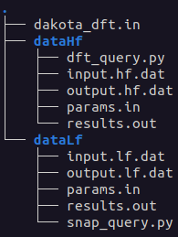
The code, the data, and the tutorials
https://dakota.sandia.gov/content/manuals
Interface examples: src/dakota-examples/official/drivers/
Directory
Two pseudo-simulations
snap_query.py
dft_query.py
Input: params.in
Output: results.out
I/O interface (direct interface with Python also available)
Dakota input file: dakota_dft.in
https://github.com/anhvt2/psi-k-tutorials-2021
Notes:
21

Slide 22
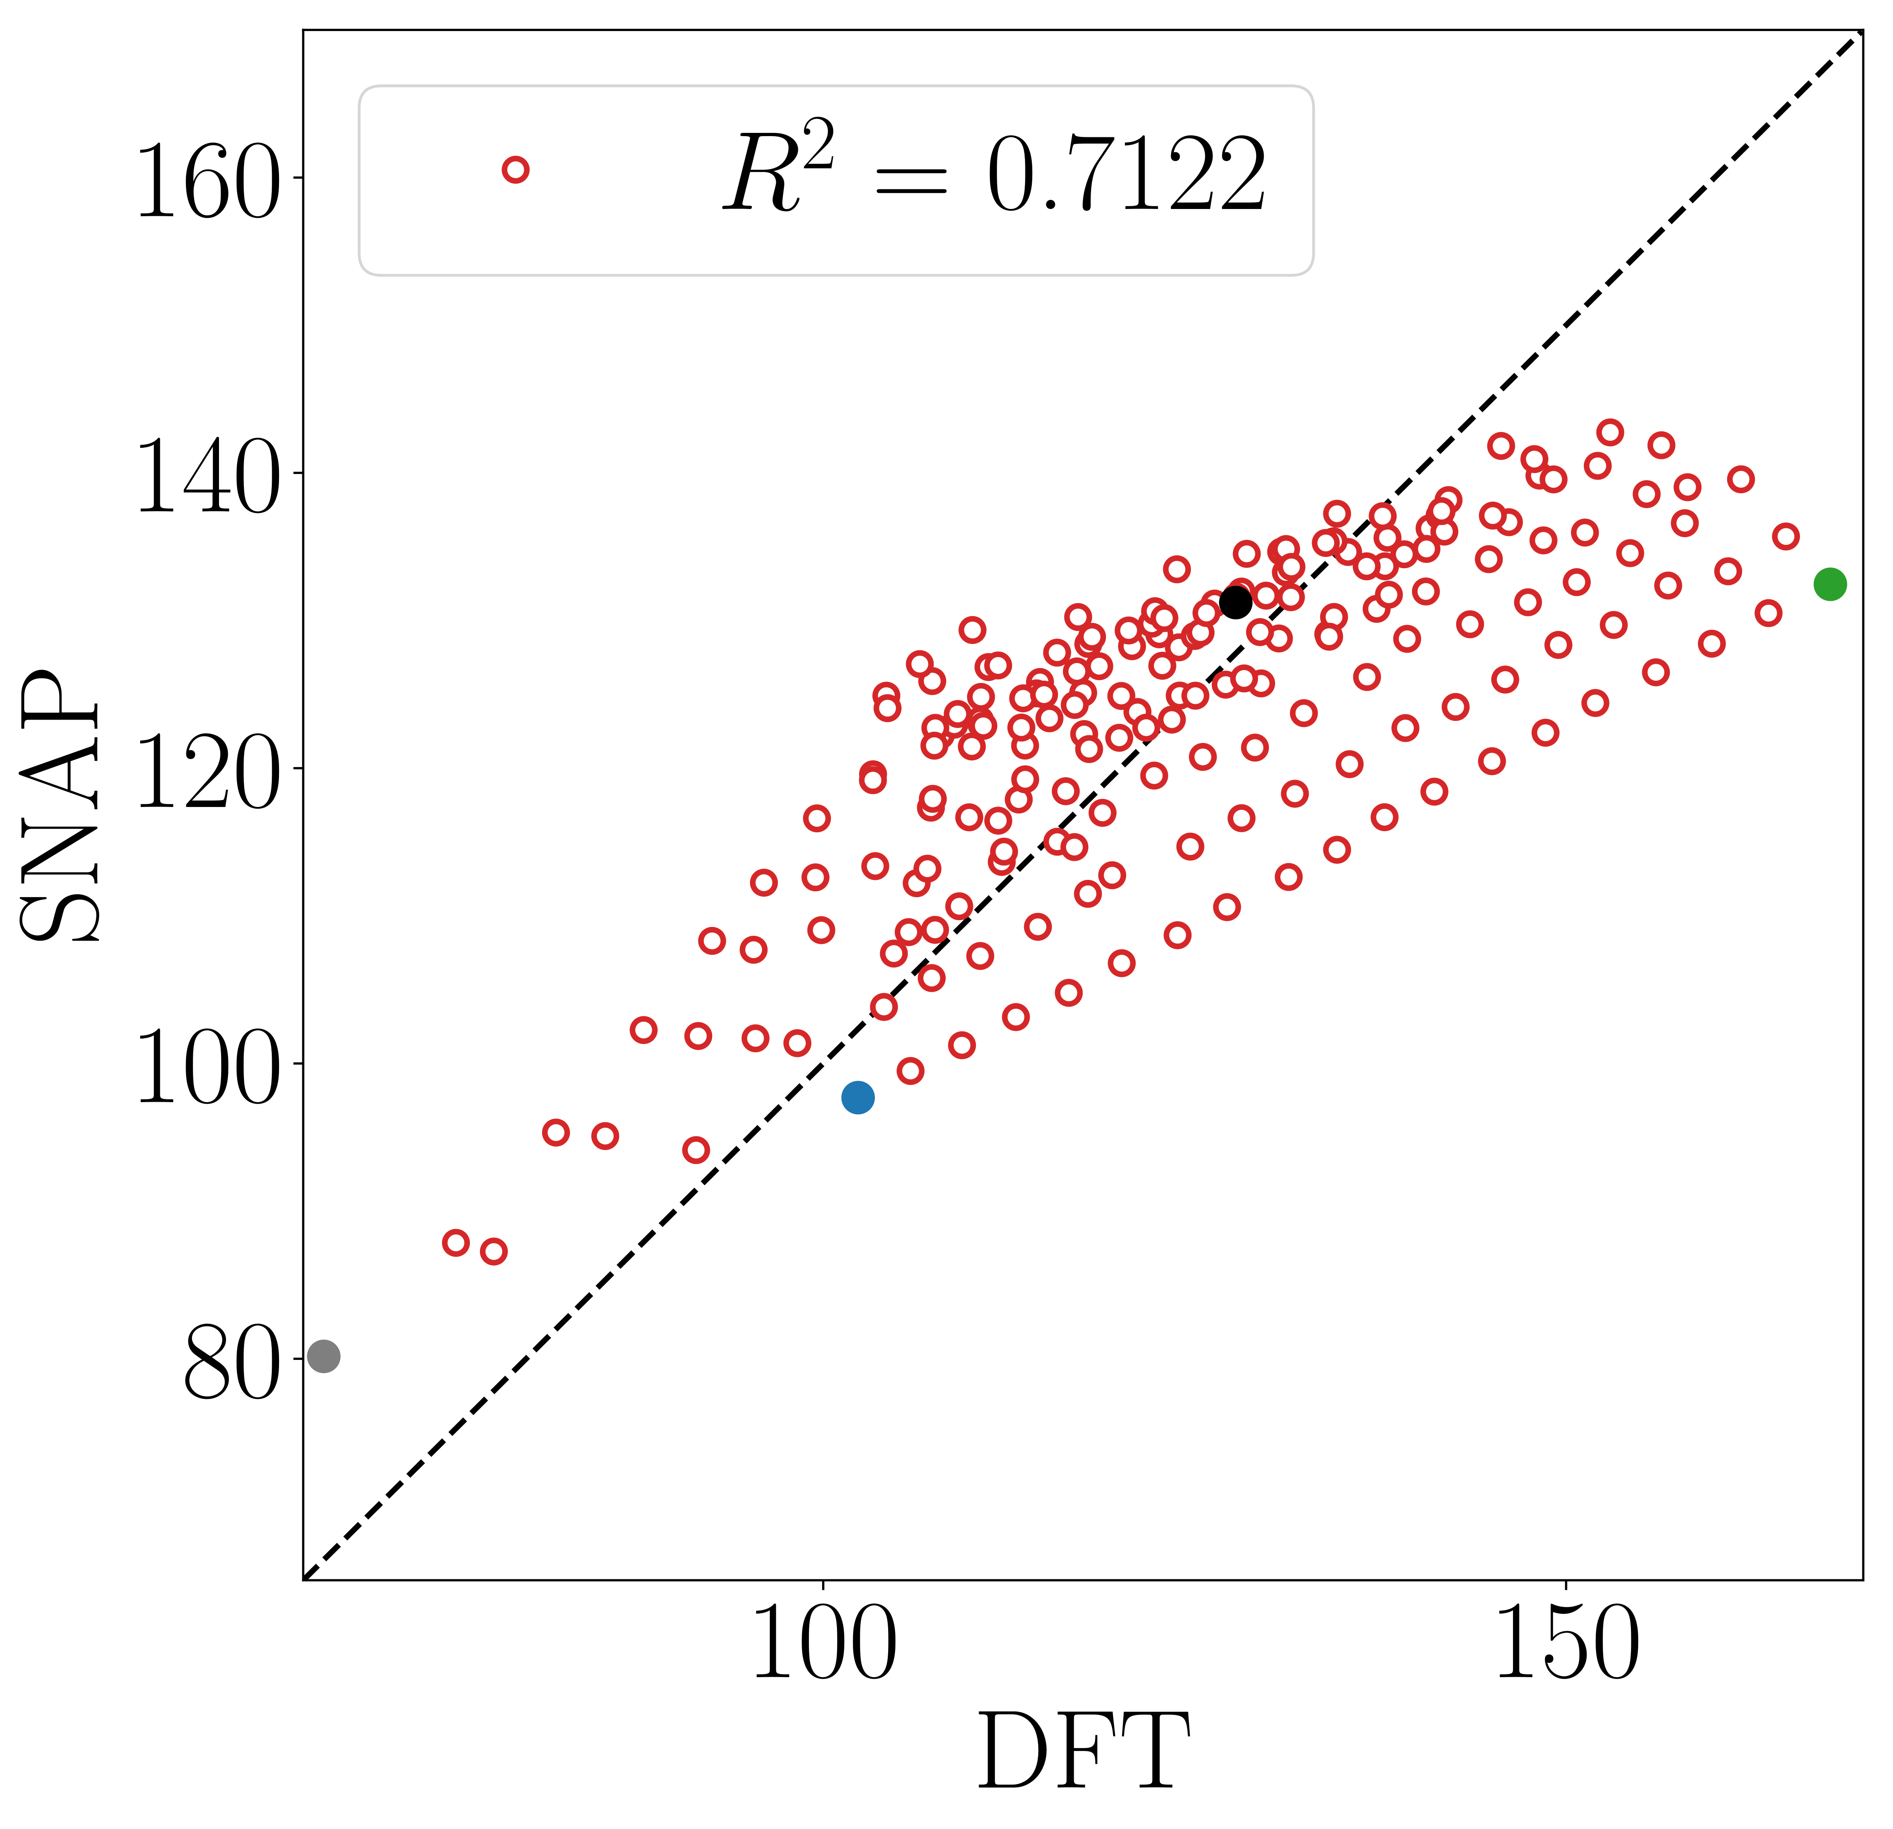
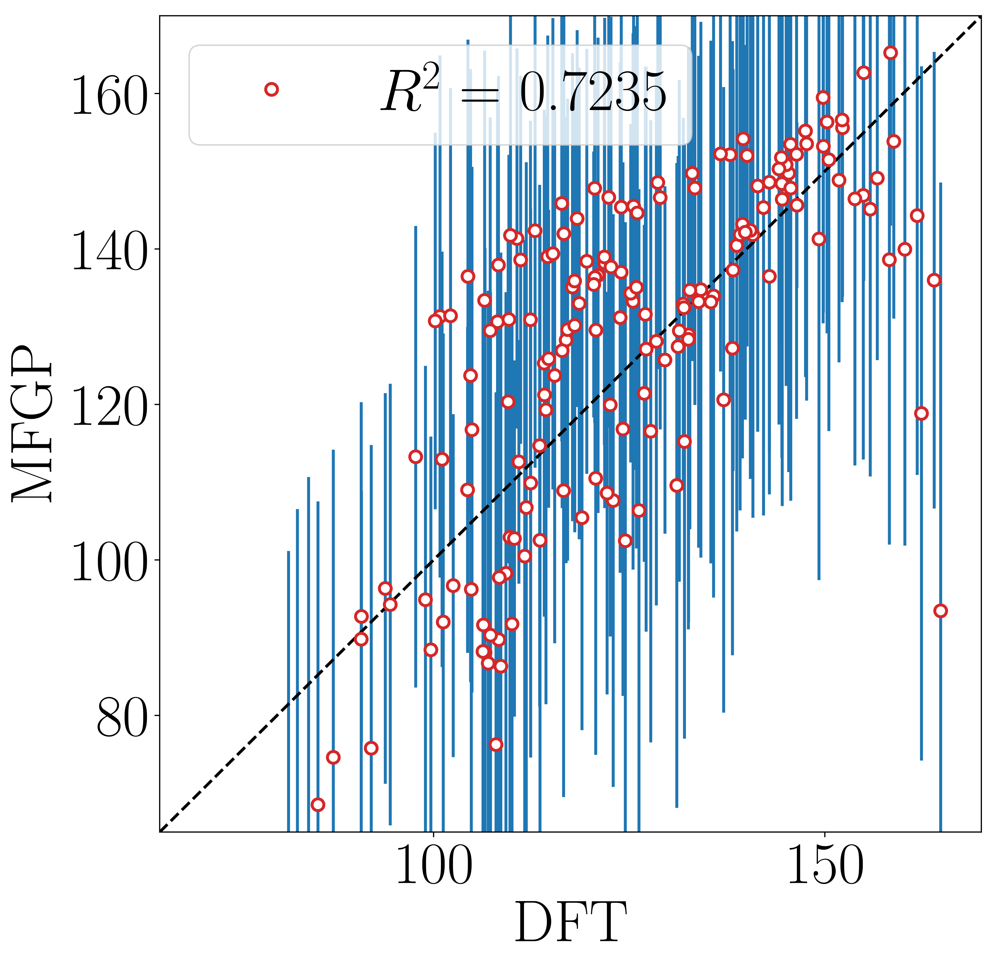
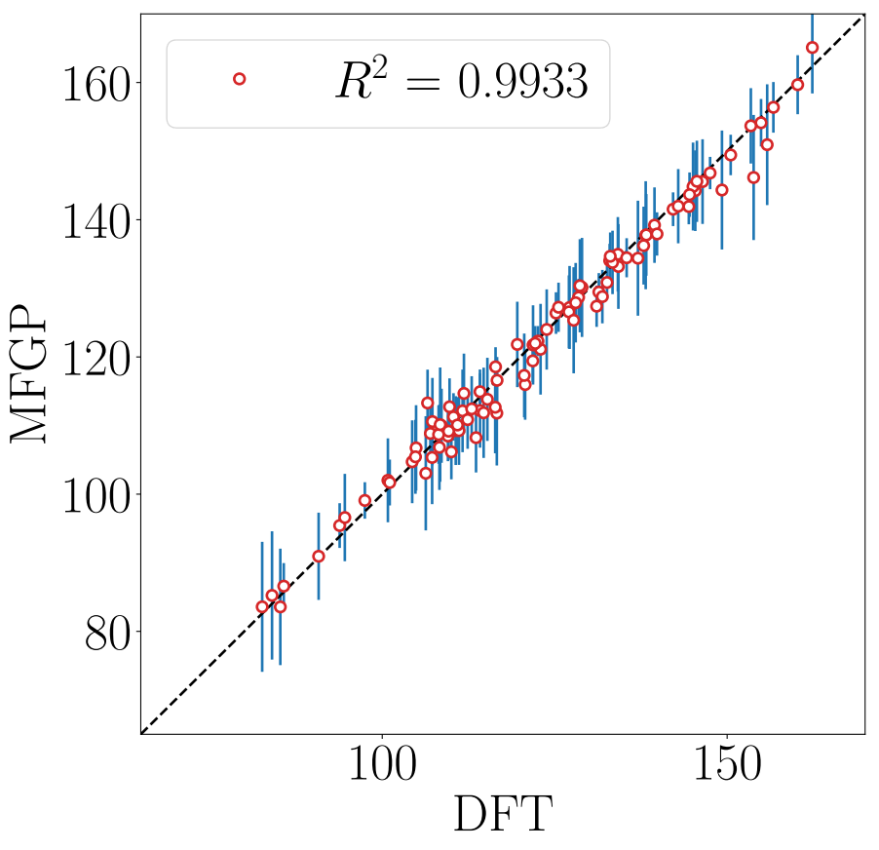
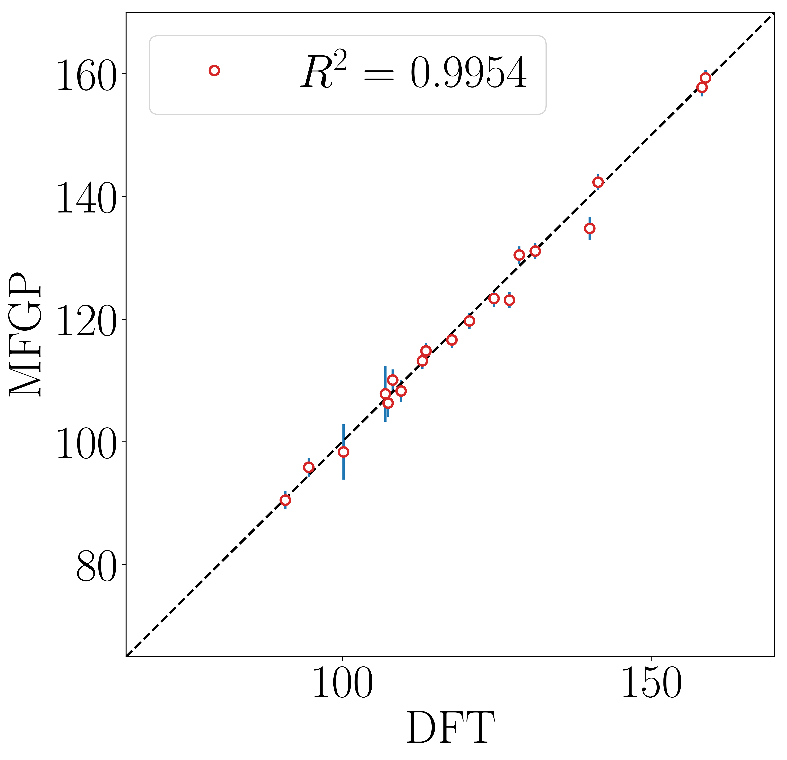
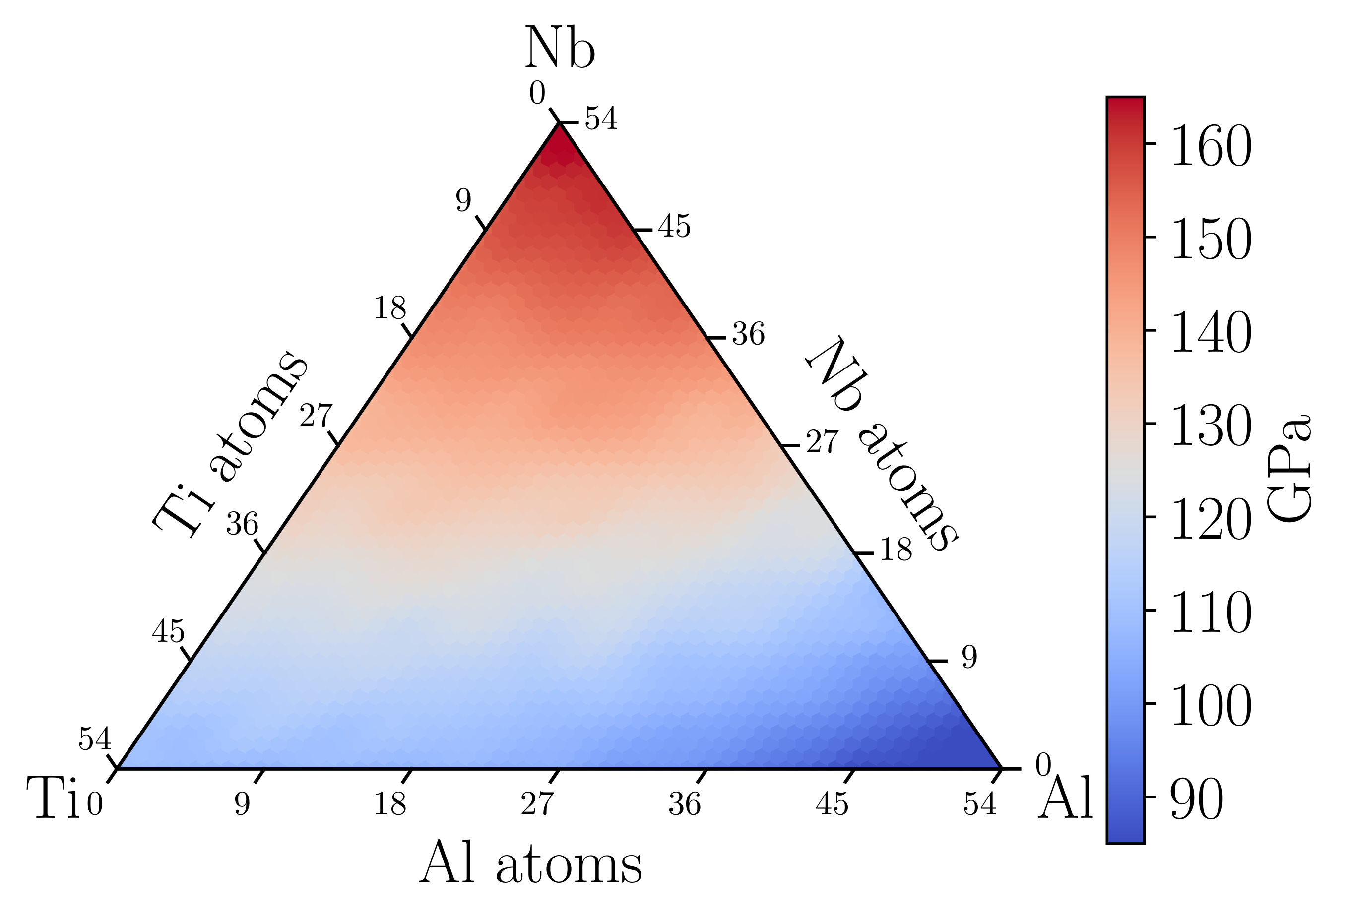
Results: GP-MF model
Convergence of the Multi-Fidelity Gaussian Process (MFGP) model with respect to the HF data, and with an increasing percentage of the training set (bulk modulus values).
LF vs HF
MFGP (10%) vs HF
MFGP (50%) vs HF
MFGP (90%) vs HF
MFGP vs HF bulk modulus diagram:
HF bulk modulus predictions
MFGP bulk modulus predictions

Slide 23
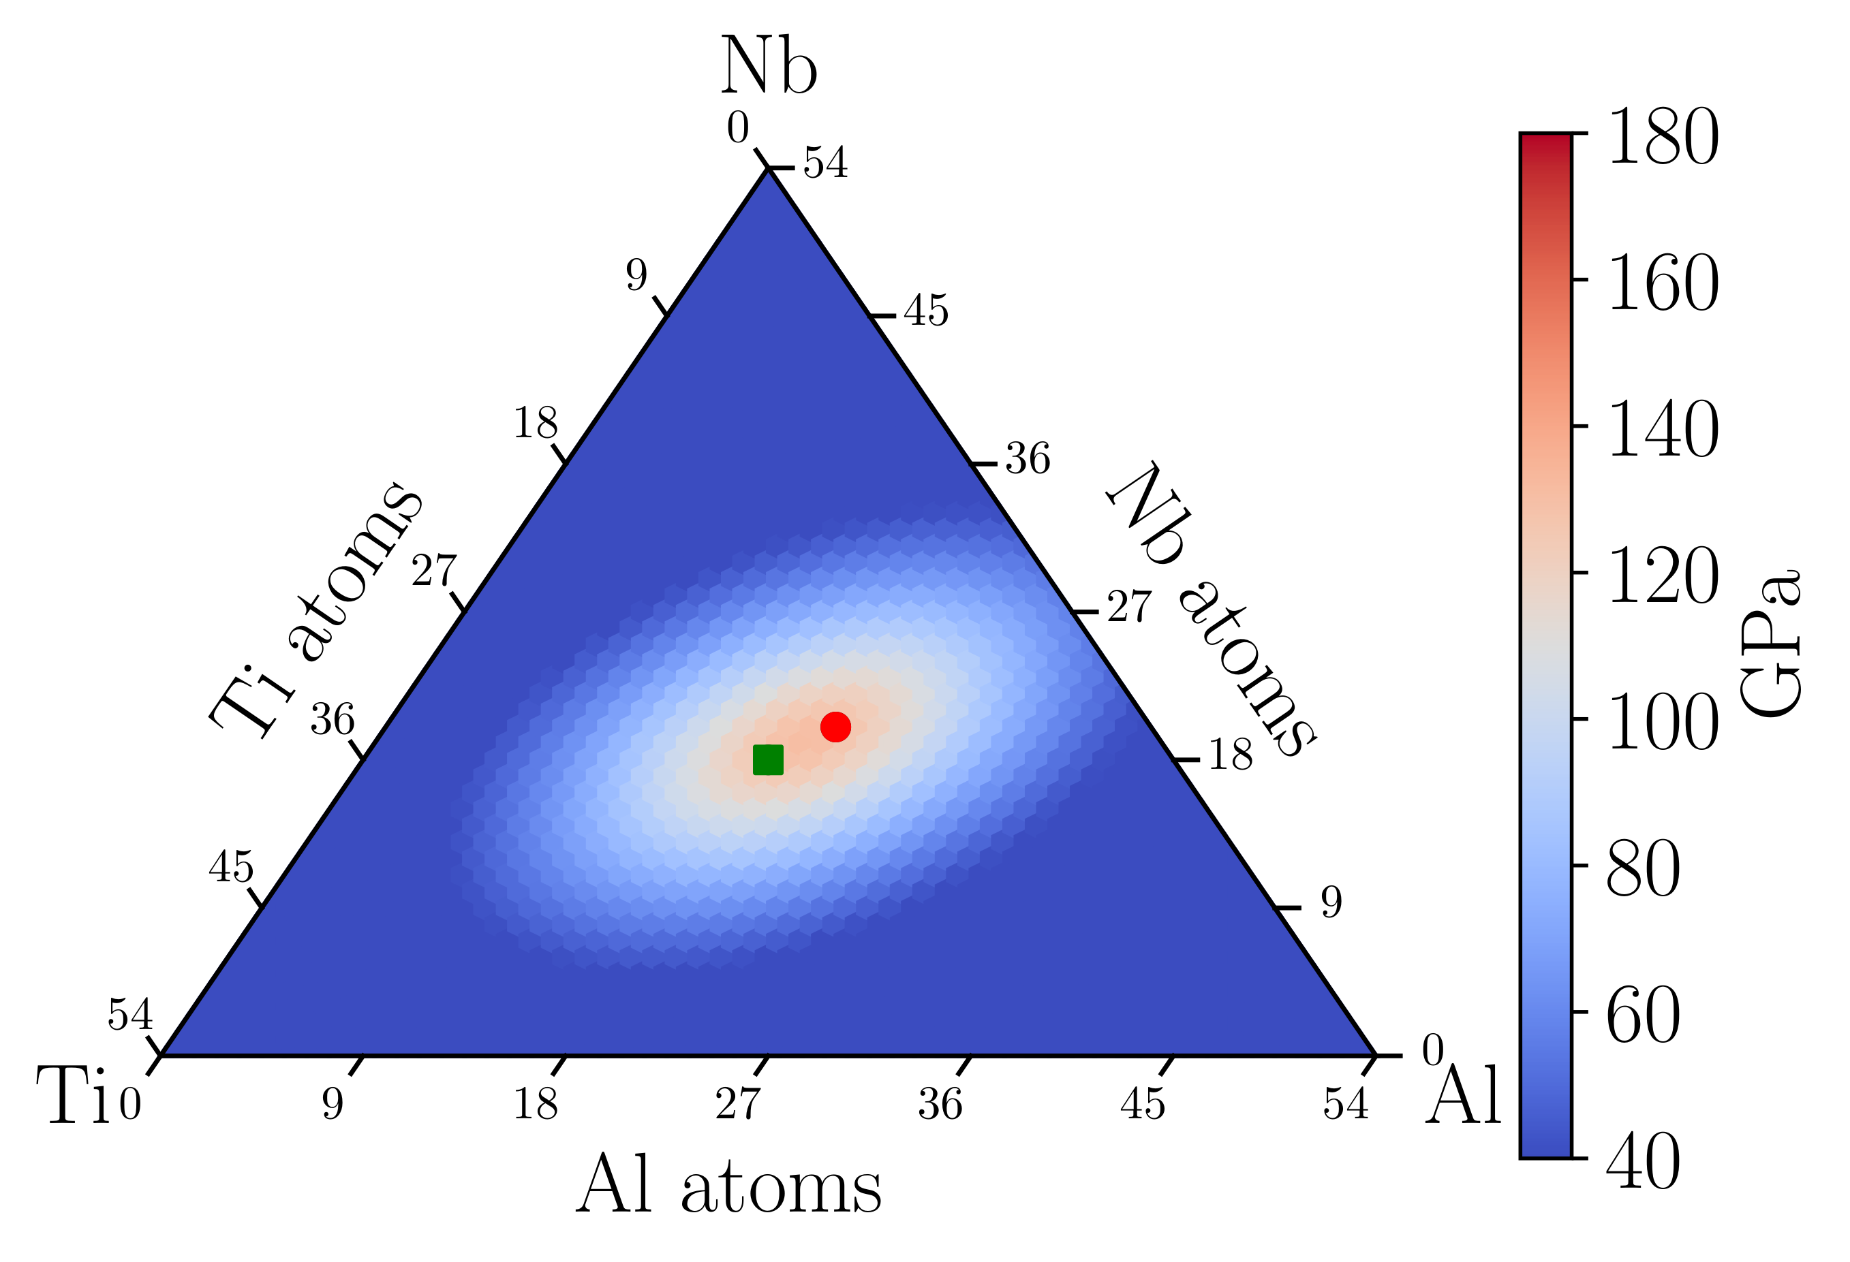
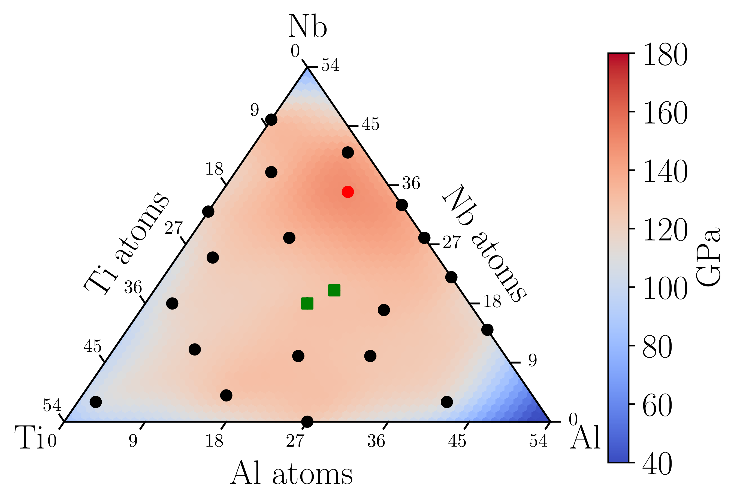
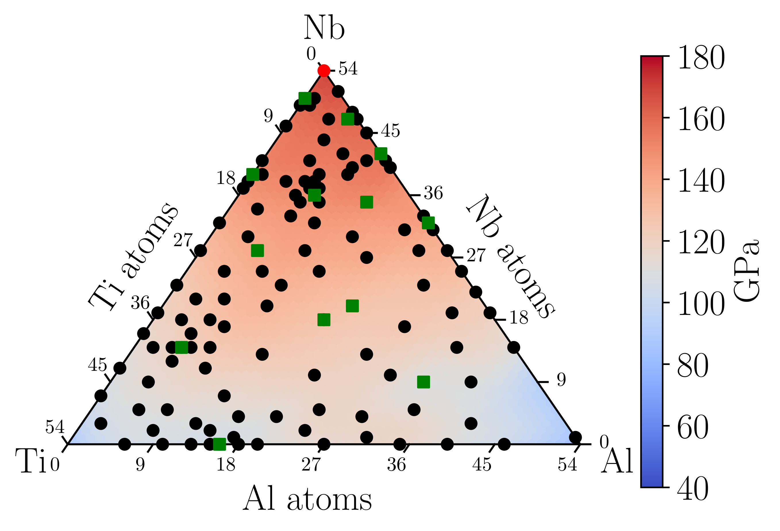
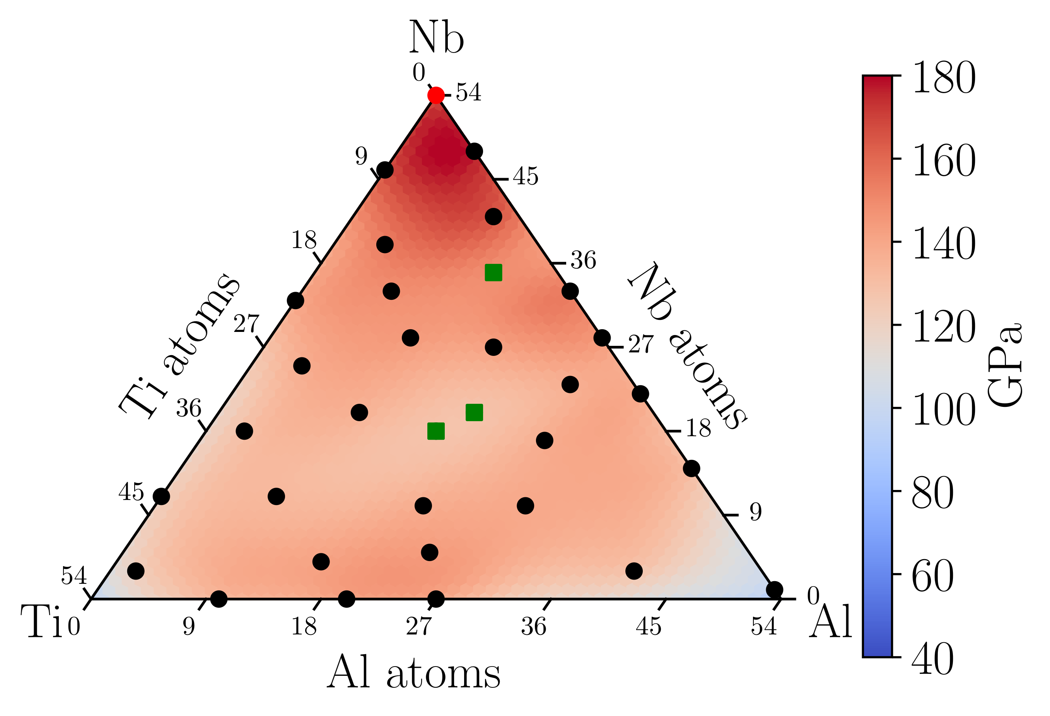
Results: MF Bayesian optimization
We performed a multi-fidelity Bayesian Optimization (MFBO) research of the optimum bulk modulus value across the AlNbTi composition space diagram:
MFBO: Iteration 5
MFBO: Iteration 25
LF evaluation
HF evaluation
Best HF point so far
MFBO: Iteration 131
MFBO: Iteration 36
The optimum bulk modulus value is located at iteration 36, after only 4 expensive HF evaluations.

